Slide 2
GDI+ Objectives
Introduction to Graphics with GDI+
The Graphics class
Introduction to Graphics Objects
Understanding the Font class
Working with Advanced GDI+

Slide 3
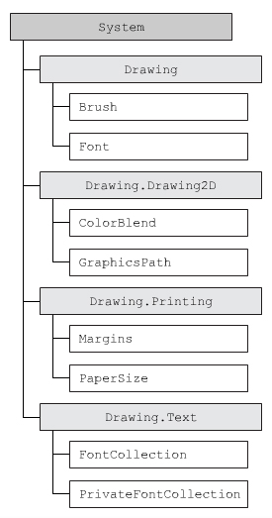
GDI+ class
Create and render Graphic
Display information on the computer screen, printer…
Notes:
Render : to cause someone or something to be in a particular state

Slide 4
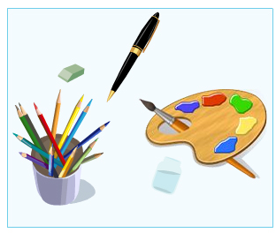
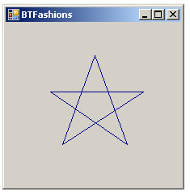
Device Context Graphics Objects
Device Context is a DataStructure that contains information about different graphic objects
Pen, Brush …
Draws Image, Graphics on any device
Graphics Objects : Pen ( draw lines ) , Brush …

Slide 5
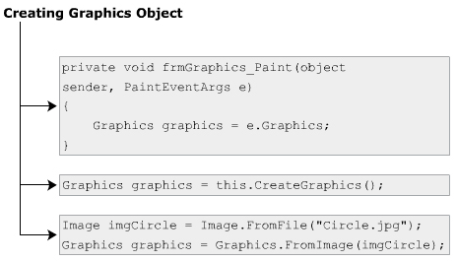

Graphics Object
To Draw various object on any device
Properties: Clip, DpiX, DpiY, PageUnit, IsClipEmpty, IsVisibleClipEmpty
Methods: Clear, DrawArc, DrawLine, DrawString, DrawBezier, DrawRectangle, FillRectangle, FillRegion, FromImage
Notes:
Clip: set/get a region that limits the drawing surface.
DpiX: get the horizontal resolution of current Graphics
PageUnit: get/set the unit measure used for page coordinate

Slide 6

Color structure
Provided by the GDI+ to provide various Color
This structure defines the alpha , red , green , blue value , which are the four primary components of the structure
Alpha component → increase the transparency of the color
Property | A, B, Blue, G, Green, R, Red, Name
Method | FromArgb, FromName, ToArgb, ToString
Notes:
Property:
A: get alpha value specify the transparency of color.
B, Blue : get blue component value/ system-defined blue color
Name : get the name of currently used color.
Method:
FromArgb: create color structure consisting of four 8-bit alpha,red, green, blue values
ToArgb: get the 32-bit argb values.
FromName: create color structure from the mentioned name of predefined color

Slide 7
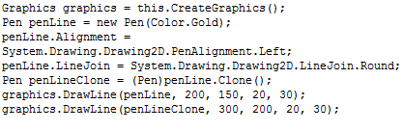
Pen class
Property | Alignment,Brush, Color, LineJoin, Transform
Method | Clone, Dispose
Notes:
Transform: get/set the geometric transformation for the pen
LineJoin: get/set the style of joining the ends of 2 consecutive lines.

Slide 8
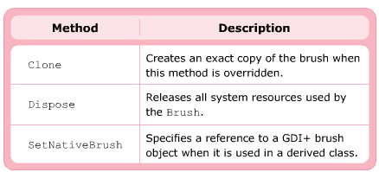
Brush class
Graphical shapes can be filled with color by using the Brush class
This is a abstract class – therefore you can use its derived classes bellow :
SolidBrush, HatchBrush, TextureBrush, LinearGradientBrush, PathGradientBrush

Slide 9
Font class
Provide the font face, size and style attributes to format text (System.Drawing namespace)
GDI fonts : (in folder Fonts of system- “Arial”)
Device fonts are used for output devices such as monitors or printers
Property | Bold, Italic, Underline, Strikeout, FontFamily, Style, Name
Method | GetHeight, ToString

Slide 10
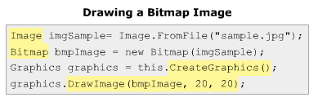
Display Image
DrawImage(Image, Point)
DrawImage(Image, float, float)
DrawImage(Image, int, int, int, int)

Slide 11
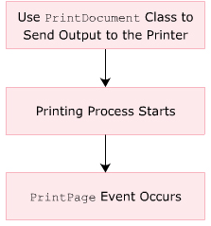
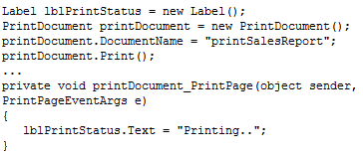
Printing GDI+ Object
Using PrintDocument class to print data and Image

Slide 12
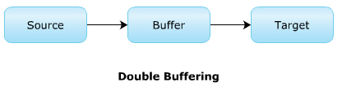
Double Buffering
One of the most problem with a complex image (complex combination of shapes, text …) is that they flicker:
The reason is the frequent redrawing of images on the control
To overcome the problem , .NET provide the Double Buffering technique – all the drawing operations is first performed in a buffer memory. Then, from the buffer, the image is drawn on the target screen.
To implement DoubleBuffering technique:
set the DoubleBufferred property of the Control class to TRUE
invoke the SetStyle() method of the Control class to set the OptimizedDoubleBuffer value to TRUE.

Slide 13
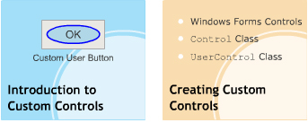
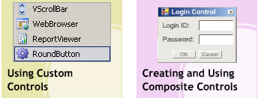
Custom Control Objective
Introduction to Custom Controls
Creating Custom Controls
Using Custom Controls
Creating and Using Composite Controls

Slide 14
Features
User-defined validation:
Allow to create validation forms used across multi-applications.
Allow to define the type of validation on the different controls.
Customized design:
Allow to design user interface of custom control, involving where and how the controls are placed and designed.
Types of custom control:
Composite : Inherit the UserControl class, combine some controls
Extended: Inherit any Windows Form control
Custom: Inherit Control class
Syntax for create simple control:
Custom control : public partial class <CustomControl> : Control
Composite control: public partial class <UserControl> : UserControl

Slide 15
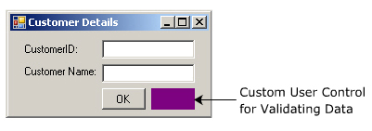
Steps to create Simple Custom controls
Define a class
Define properties
Override OnPaint() method
Provide attributes
Provide resources
Compile ans deploy

Slide 16
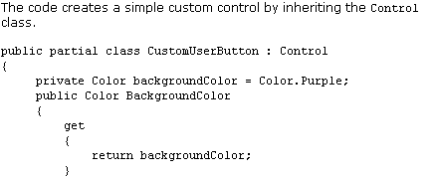
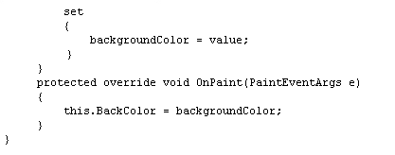
Steps to create a simple Control

Slide 17
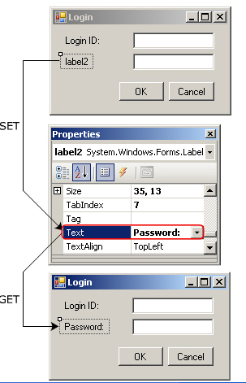
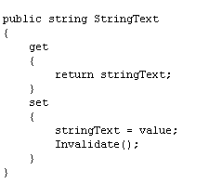
Adding properties using Accessors

Slide 18
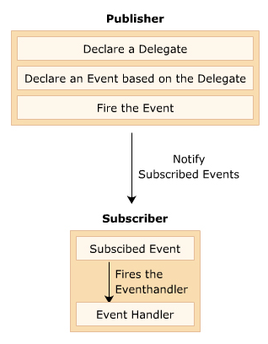
Associating events with custom controls
public event EventHandler Leave
this.btnCustom += new System.EventHandler(the_fun)
public void the_fun(object sender , EventArgs e)
{
………….
}

Slide 19
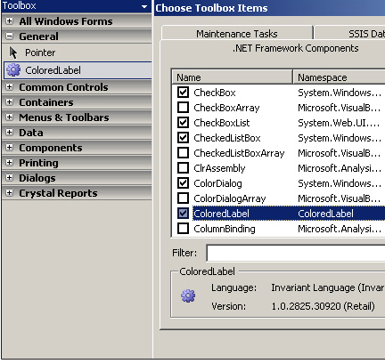
Steps for using custom controls
Right-click the Visual Studio IDE Toolbox
Click the ChooseItem option
Select .NET Framework Components tab
Click Browse and select the appropriate custom control

Slide 20
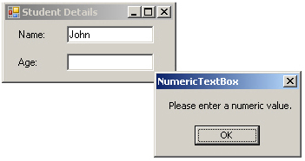
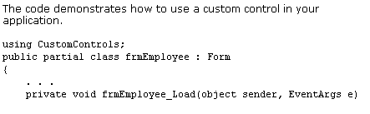
Using custom controls programmatically
Namespace of CustomControl

Slide 21

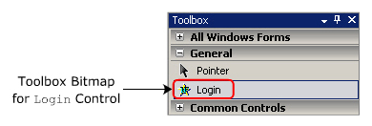
Custom controls (cont ..)
[@ToolboxBitmap(“C:\\demo.bmp”)]
public partial class CustomControl : UserControl
{
-----------------------------------
}

Slide 22
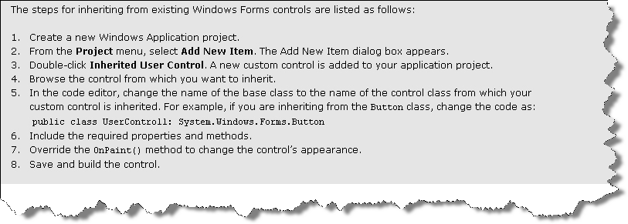
Inherit existing controls

Slide 23
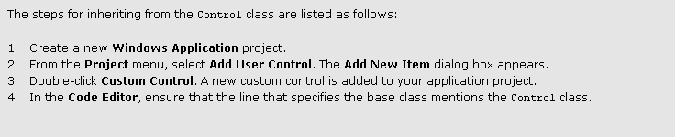
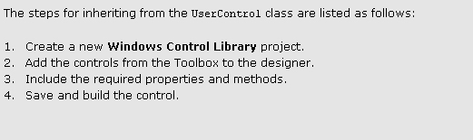
Inherit existing controls (ctn)

Slide 24
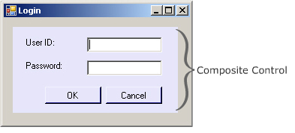
Composite Control
Allow to create graphical interfaces using one or more Windows Forms Controls
Inherit System.Windows.Forms.UserControl
Advantages:
Allow to merge data easily
Create a .dll file that acts as an assembly

Slide 25
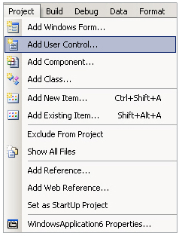
Step by Step
You can create Window Control Library project
Create a new Windows Application project
From Project menu, select Add User Control
Add Windows Forms controls to the composite control design surface
Place code in event procedures
Save the file
Build solution
The composite control appear in the Toolbox

Slide 26
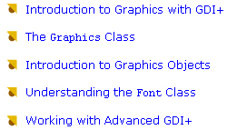
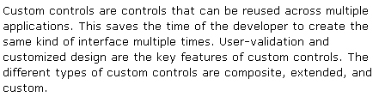
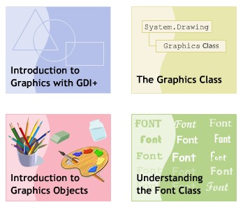
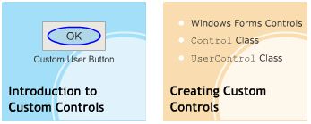
Summary

